Slide 1
Project -1
Iris Flower Classification

Slide 2
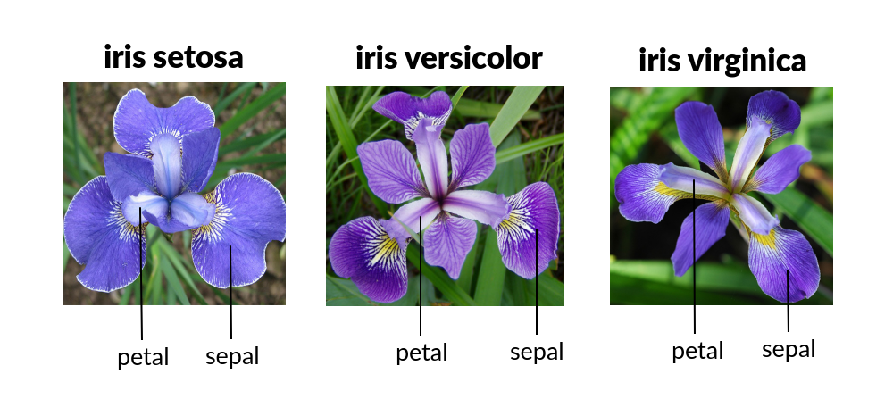
Introduction
Iris flower dataset is a classic dataset in the field of machine learning and data science.
This dataset, first introduced by biologist Ronald Fisher in 1936.

Slide 3
Objective
Our main objective with this project is to develop a machine learning model that can accurately classify iris flowers into their respective species based on these measurements. By doing so, we aim to showcase the power of machine learning algorithms in solving real-world classification tasks.

Slide 4
Methodology
"To achieve our objective, we will follow a systematic approach:
Data Exploration
Data Preprocessing
Model Development
Model Evaluation
Model Selection

Slide 5
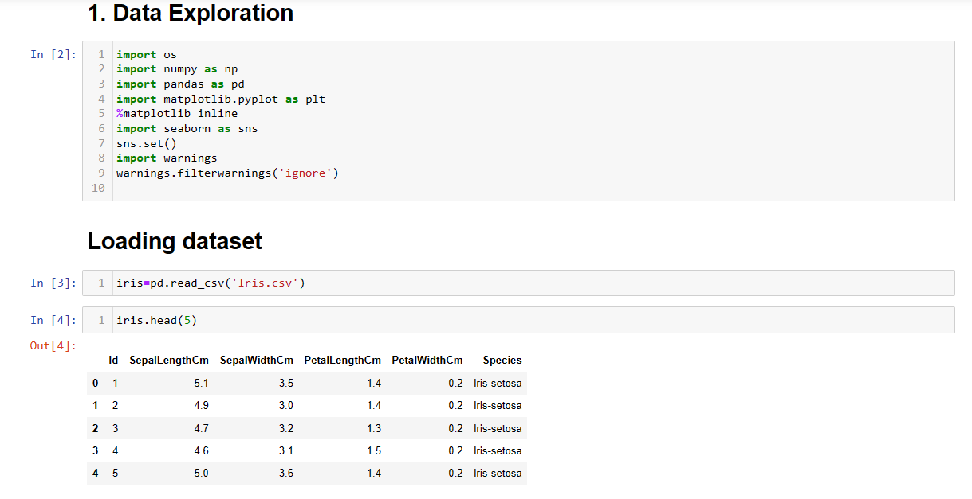
Data Exploration

Slide 6
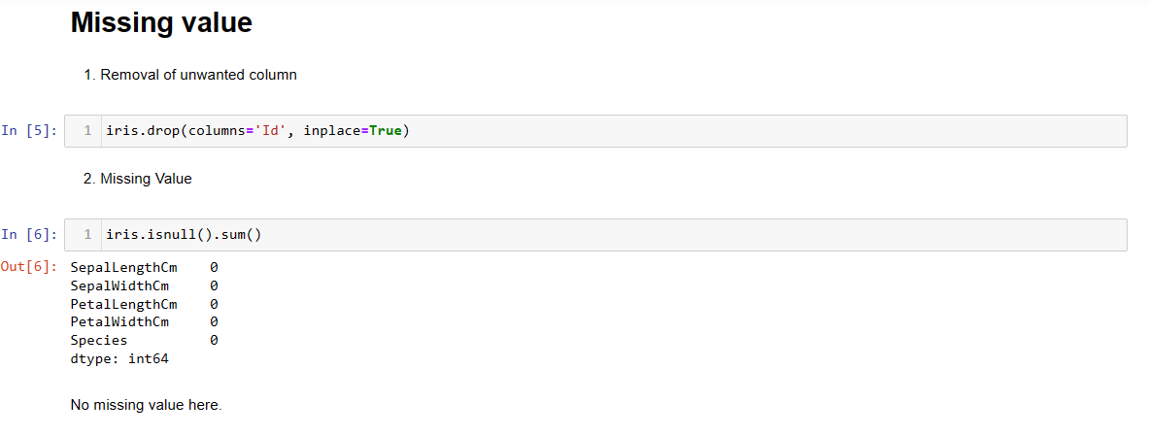

Slide 7
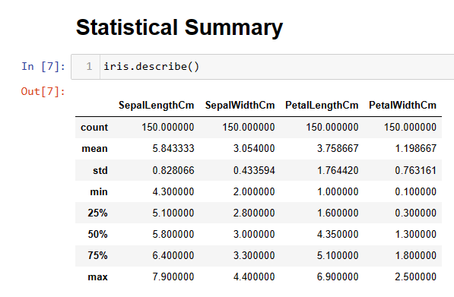

Slide 8
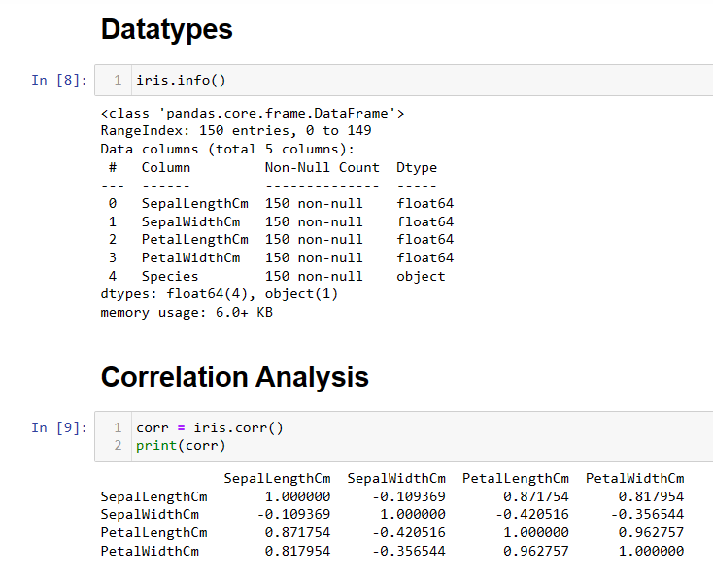

Slide 9
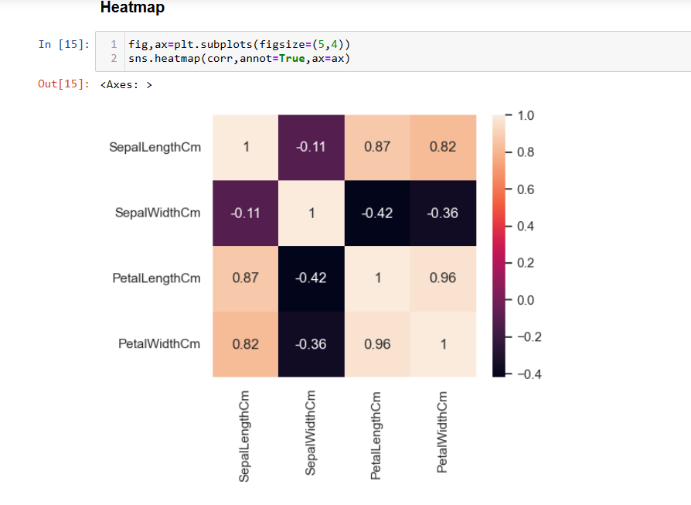

Slide 10
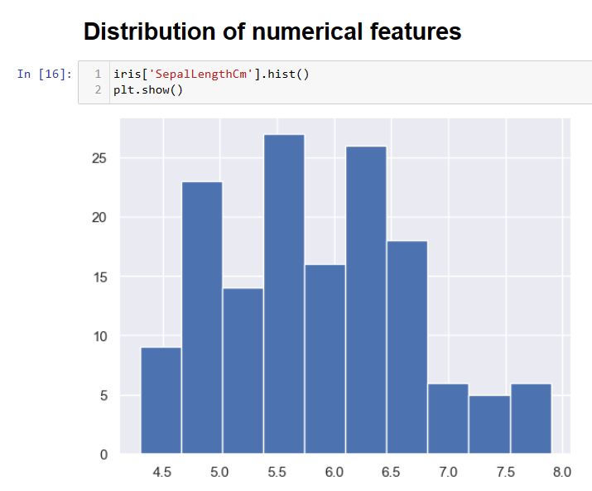
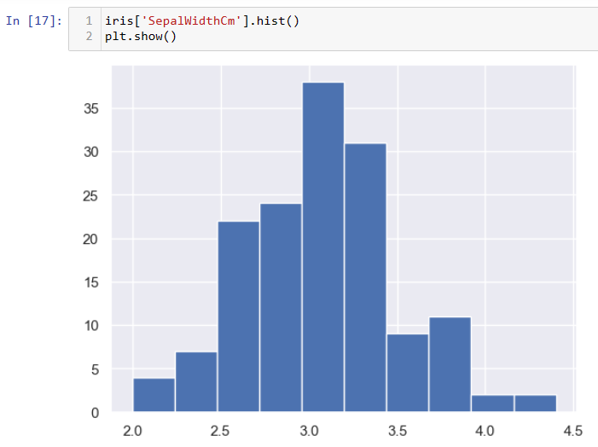
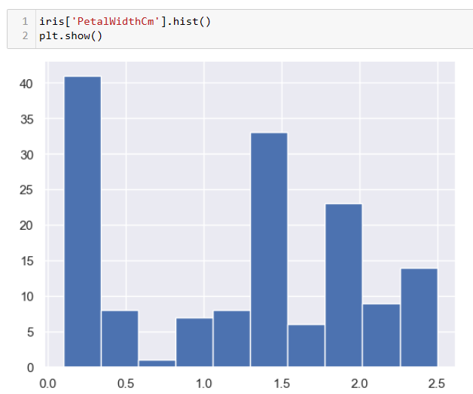
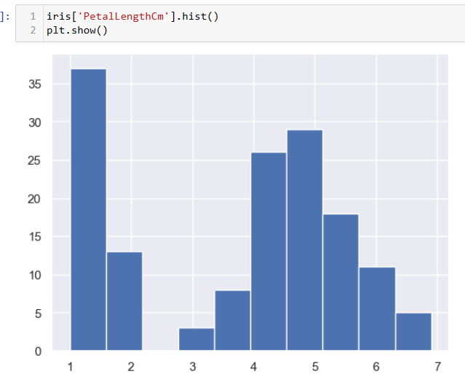

Slide 11
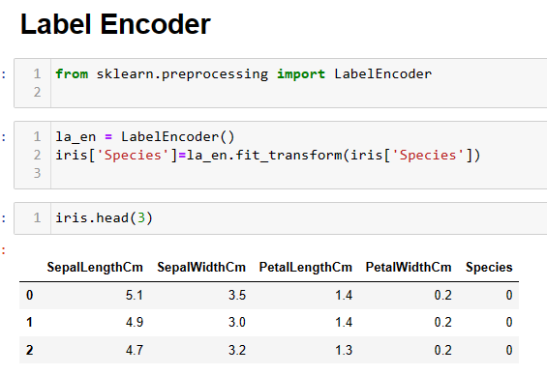

Slide 12
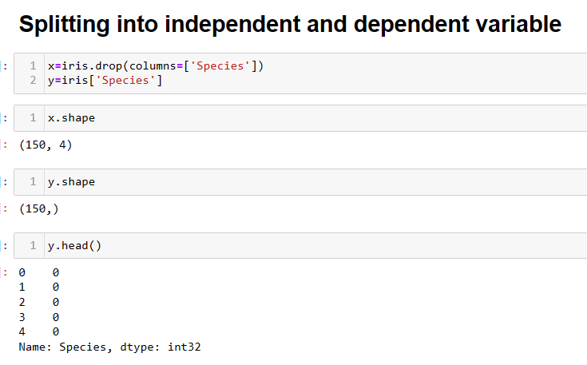

Slide 13
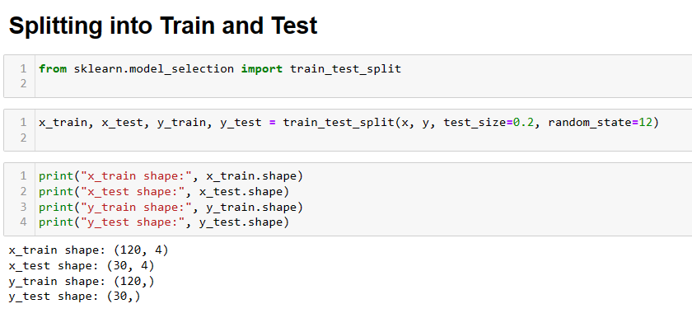

Slide 14
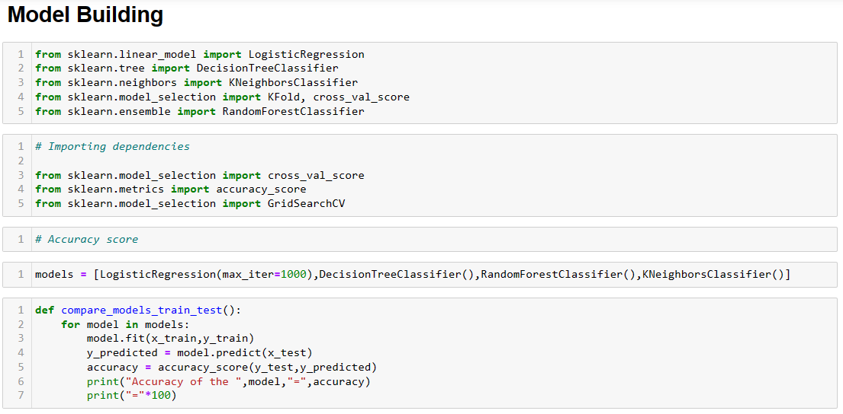
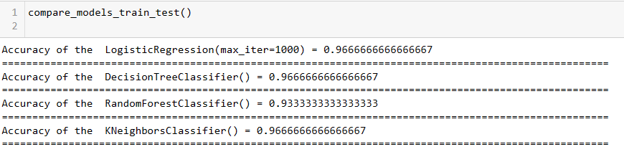

Slide 15
Cross Validation
Model Performance Estimation: Cross-validation provides a more reliable estimate of how well a model will perform on unseen data compared to a simple train/test split. By using multiple subsets of the data for training and testing, cross-validation provides a more robust estimate of model performance.
2. Model Selection: Cross-validation helps in comparing different models or different hyperparameter settings for the same model. By performing cross-validation on each candidate model, you can select the one that performs the best on average across different subsets of the data.

Slide 16
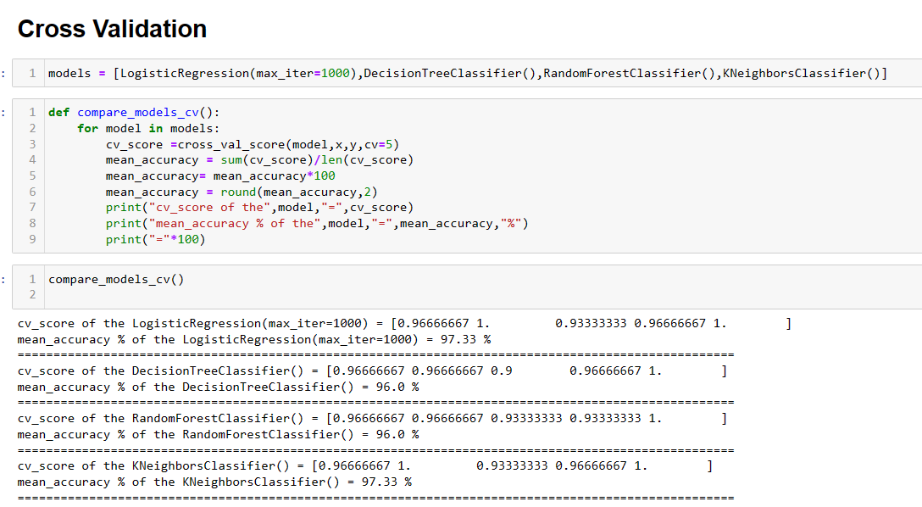

Slide 17
